Slide 1
Weather vs Home Sales in King County, WA
Data Analytics Bootcamp - API Group Project
Kaveh Amini, Yashwinie Shivanand, Yinka Adesanmi

Slide 2
Research question
Is there a relation between residential real estate sales and the weather?
To start, we aimed to examine the relationship between prices and numbers of home sales, and how these correlate to weather.
Does a relationship exist?
What is the nature of that relationship?
Notes:
* Define the core message or hypothesis of your project.
* Describe the questions you asked, and _why_ you asked them
* Describe whether you were able to answer these questions to your satisfaction, and briefly summarize your findings

Slide 3
Summary
Motivation:
What are some interesting factors that could play into when homes are closed? Suspected that price and location are not necessarily the only factors at play.
Findings:
There are no obvious/clear relationships between the dataset we used (King County, WA).
We suspect this is because of that specific region, which is generally tepid and without distinct and varied seasonal change.
Notes:
* Define the core message or hypothesis of your project.
* Describe the questions you asked, and _why_ you asked them
* Describe whether you were able to answer these questions to your satisfaction, and briefly summarize your findings

Slide 4
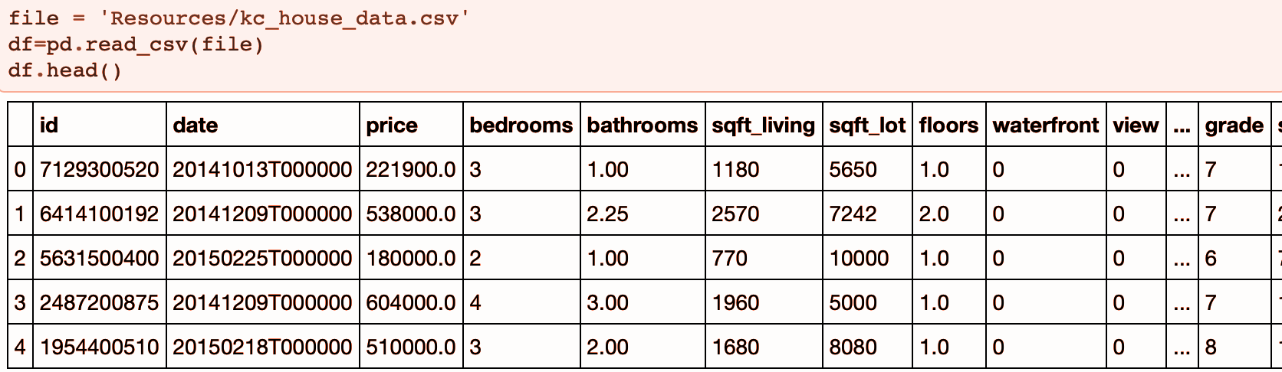
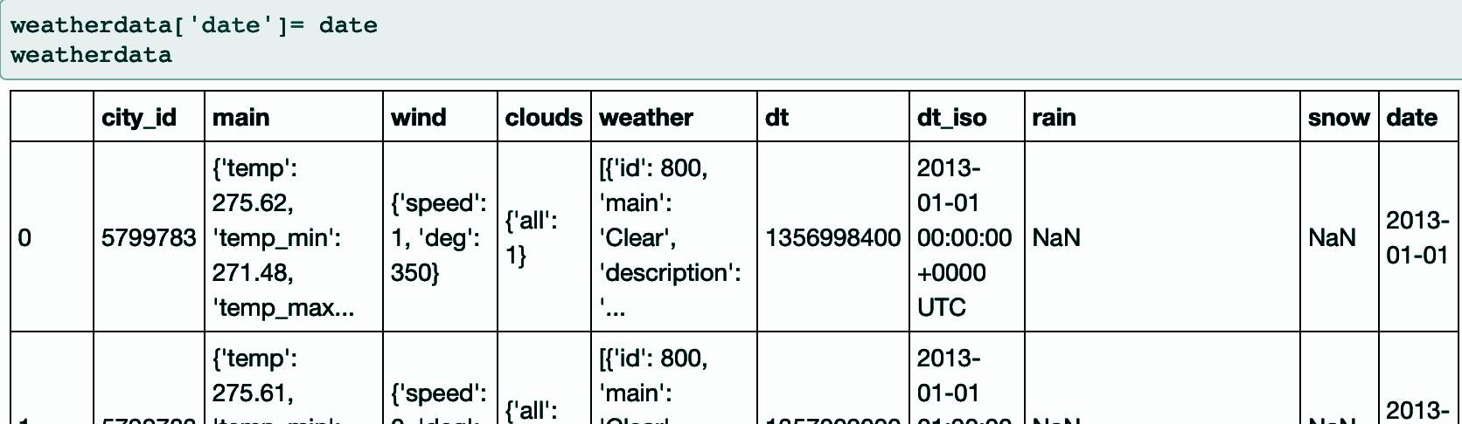
Data
We used two datasets for this analysis:
OpenWeather Historical Data
King County Real Estate Sales (May-2014 to May-2015)
Notes:
Elaborate * Questions & Data
* Elaborate on the questions you asked, describing what kinds of data you needed to answer them, and where you found it
* Data Cleanup & Exploration
* Describe the exploration and cleanup process
* Discuss insights you had while exploring the data that you didn't anticipate
* Discuss any problems that arose after exploring the data, and how you resolved them
* Present and discuss interesting figures developed during exploration, ideally with the help of Jupyter Notebook

Slide 5
Data analysis
Information finding
Clean the data and merge information so that we can compare both datasets with uniform metrics.
1
Information plotting
Plotted basic scatter plots to learn about the rich dataset we acquired, only to discover that no obvious correlation could be seen.
2
Information fact-checking
Investigated biases that could be impacting the results of our analysis, and what kinds of information we would need to remedy this situation.
3
Notes:
* Discuss the steps you took to analyze the data and answer each question you asked in your proposal
* Present and discuss interesting figures developed during analysis, ideally with the help of Jupyter Notebook → open and run through master jupyter notebook here

Slide 6
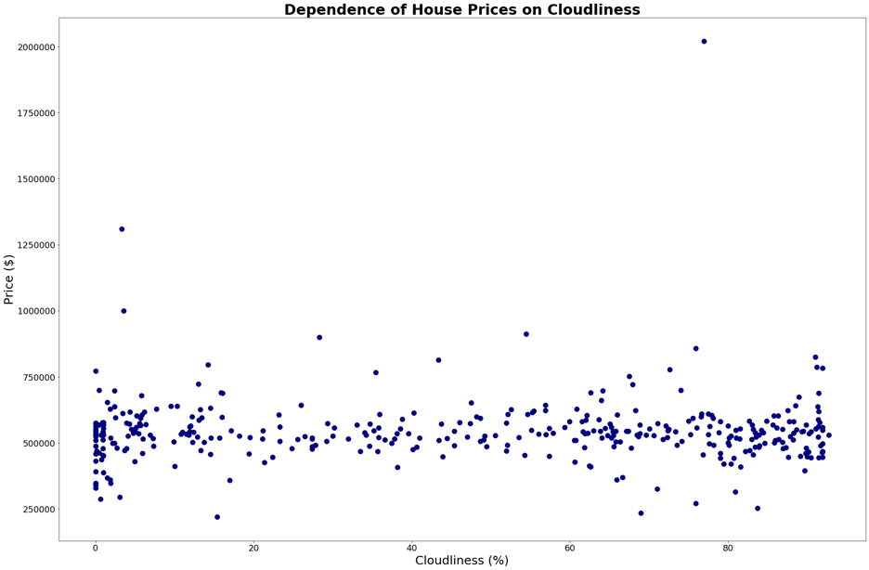
Findings
(1) No dependence found between house prices and cloudiness throughout the year.

Slide 7
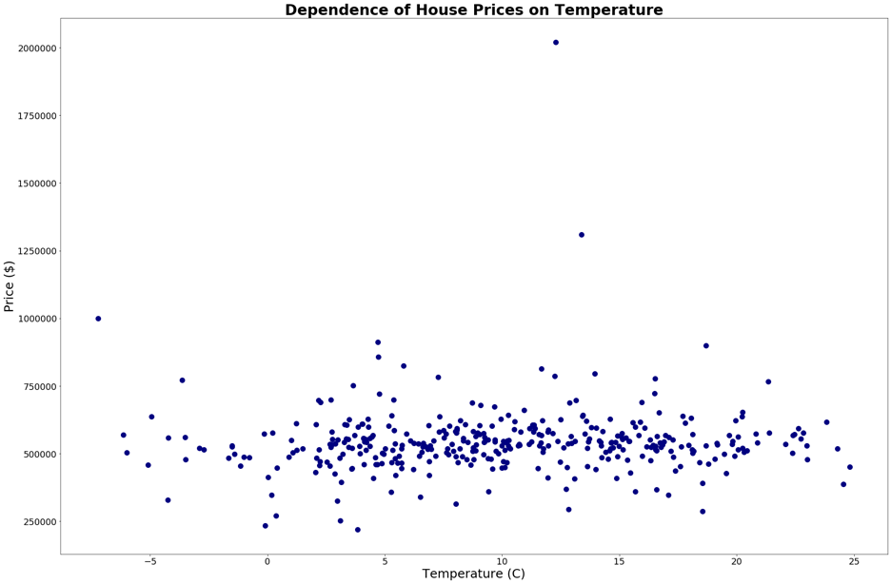
Findings
(2) No dependence found between house prices and temperatures throughout the year.

Slide 8
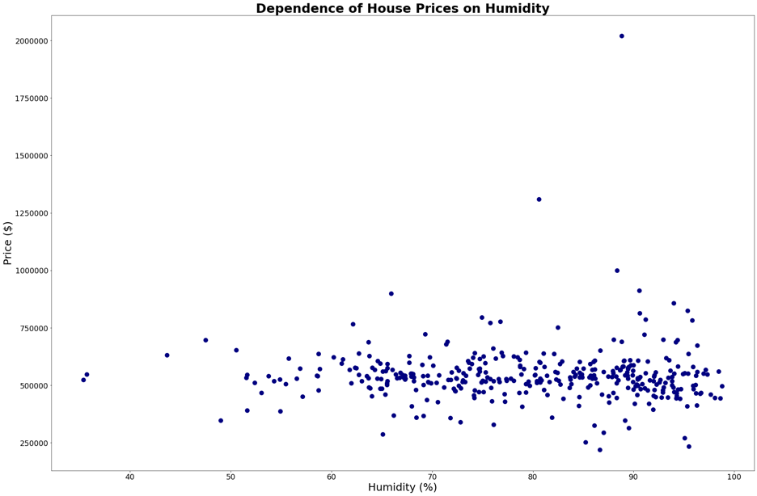
Findings
(3) Minimum/basically no dependence between house prices and humidity throughout the year.

Slide 9
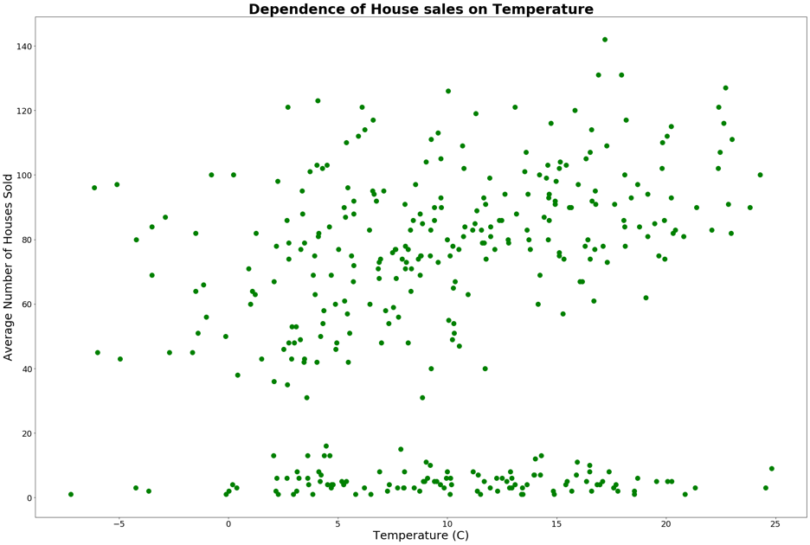
Findings
(4) No clear correlation between average number of houses sold and temperature, though two distinct populations appear.

Slide 10
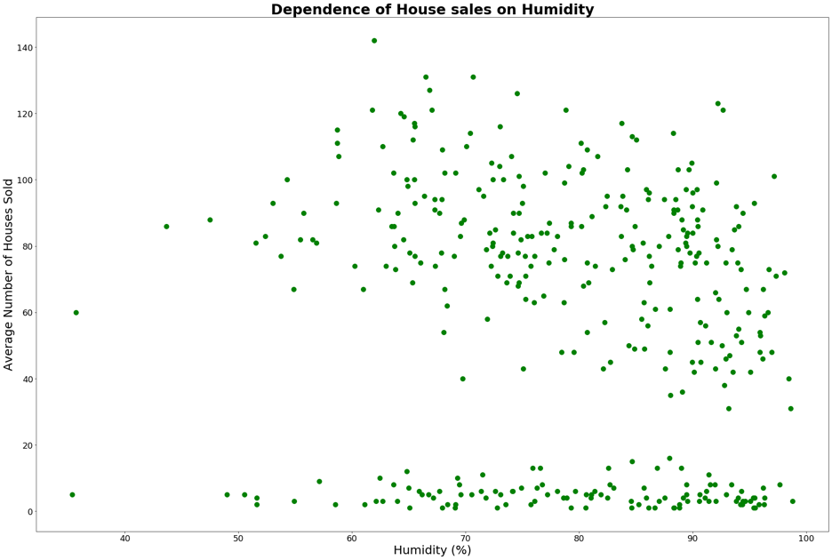
Findings
(5) No clear correlation between average number of houses sold and humidity. Two distinct populations appear again.

Slide 11
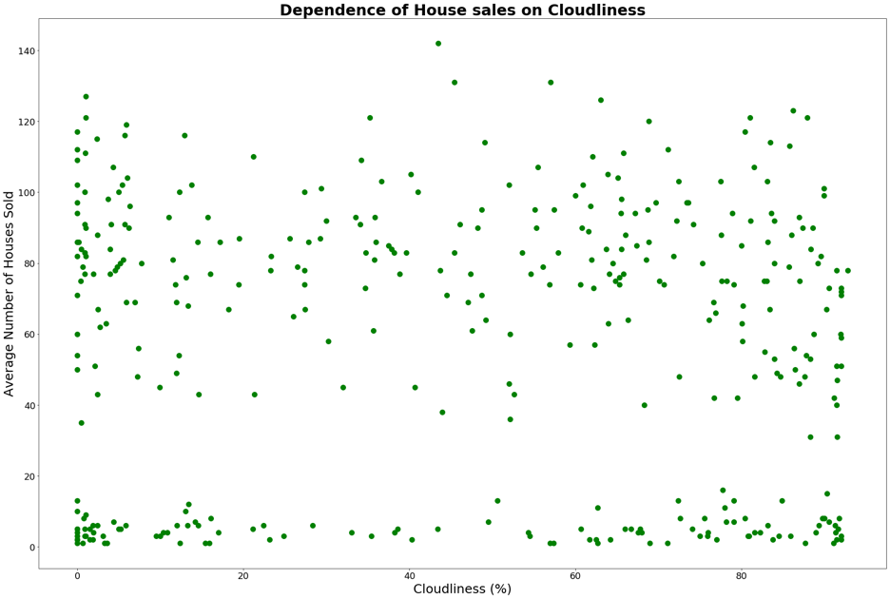
Findings
(6) No clear correlation between average number of houses sold and cloud cover. Two distinct populations appear again.

Slide 12
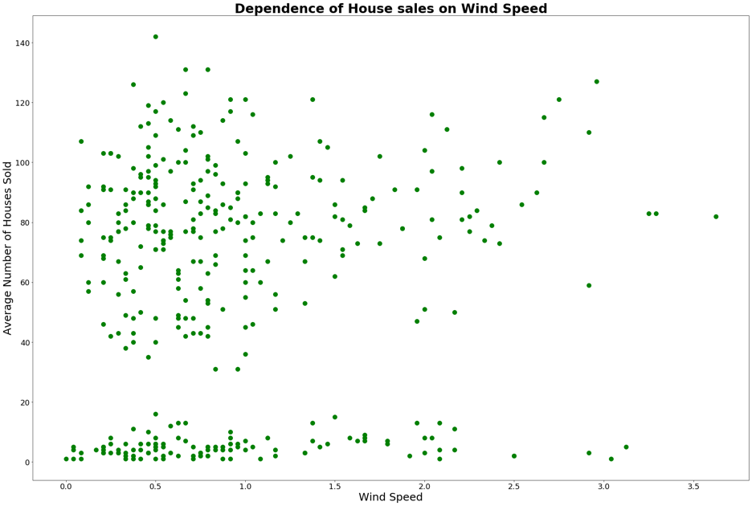
Findings
(7) Minimum/basically no correlation between average number of houses sold and wind speed. Two distinct populations appear again.

Slide 13
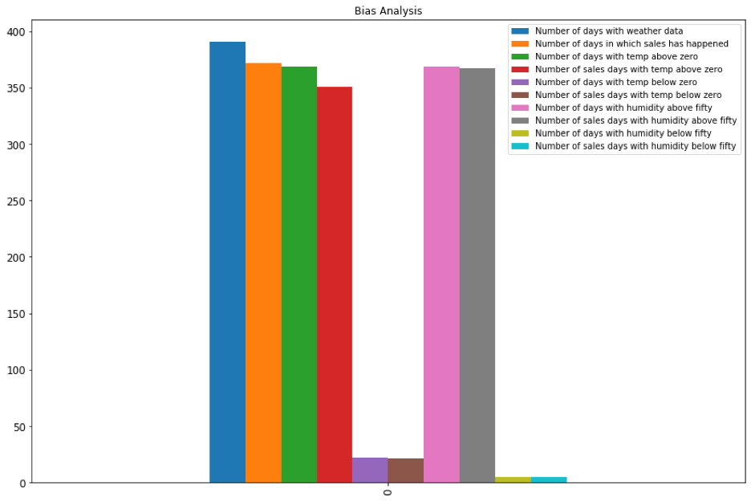
Findings
(8) Bias Analysis

Slide 14
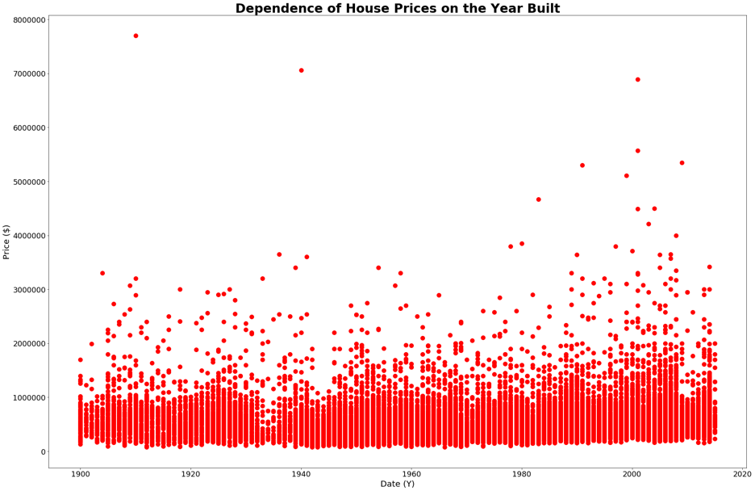
Findings
(9) Some correlation between when houses are built and its selling price.

Slide 15
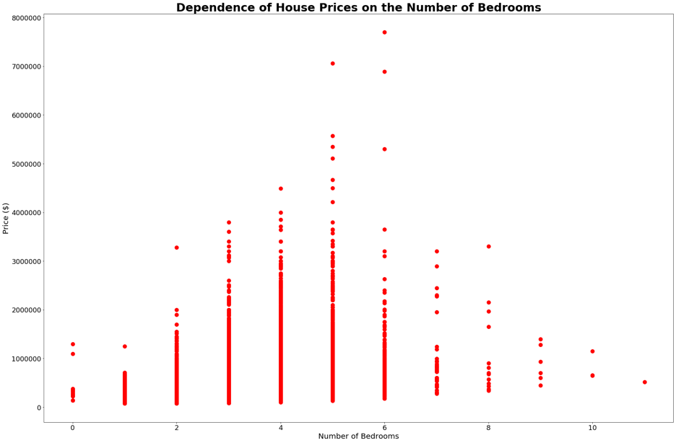
Findings
(10) Some common sense findings when plotting house selling price against its number of bedrooms.

Slide 16
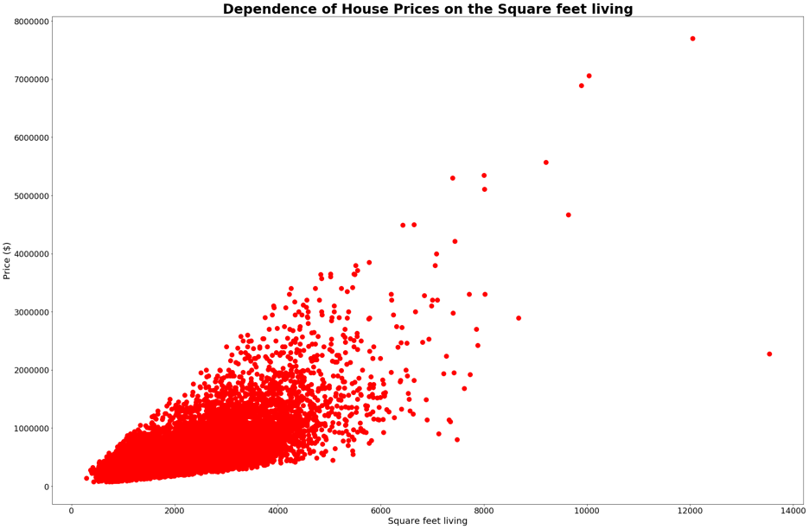
Findings
(11) A clear pattern emerges between house sizes and house selling price.

Slide 17
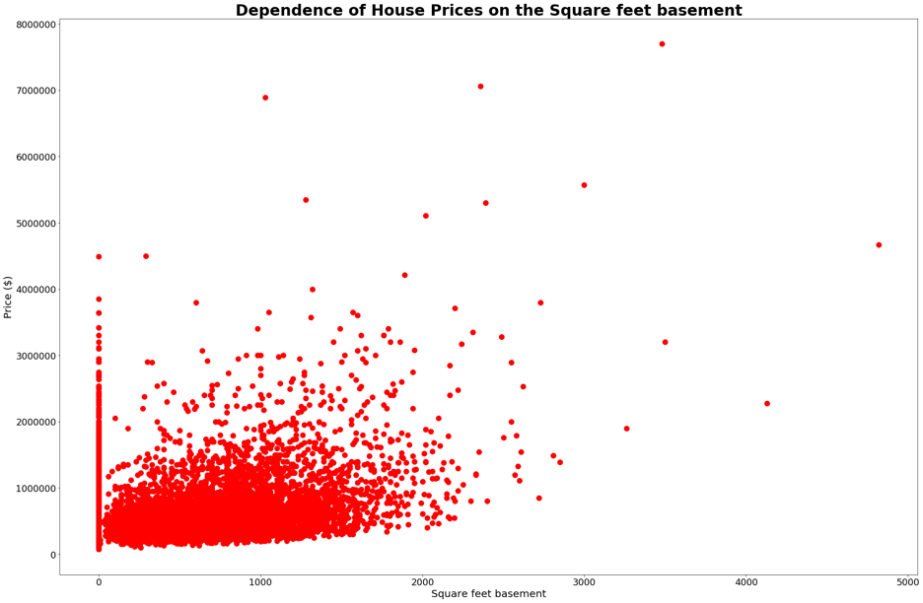
Findings
(12) Clear correlation between house prices and the square feet of its basement.

Slide 18
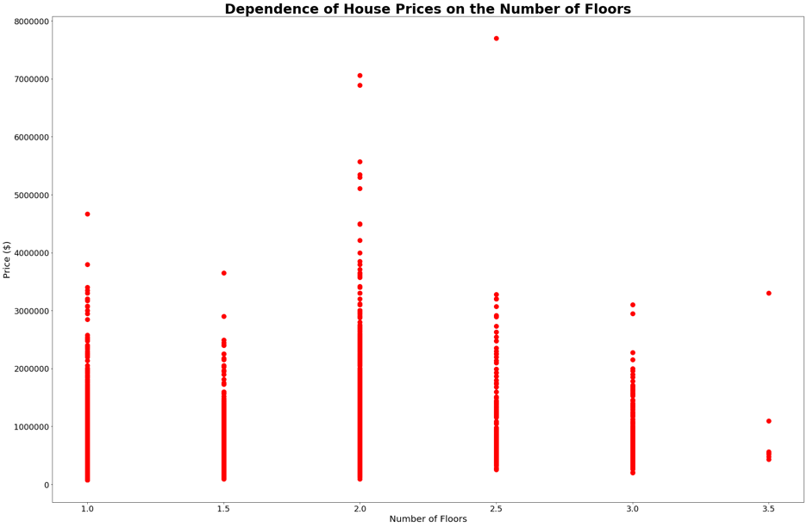
Findings
(13) Dependence between house prices and the number of floors of that house.

Slide 19
Conclusions
Post-mortem thoughts
Notes:
* Discuss any difficulties that arose, and how you dealt with them
*Discuss any additional questions that came up, but which you didn't have time to answer: What would you research next, if you had two more weeks?

Slide 20
Questions?

